Slide 1
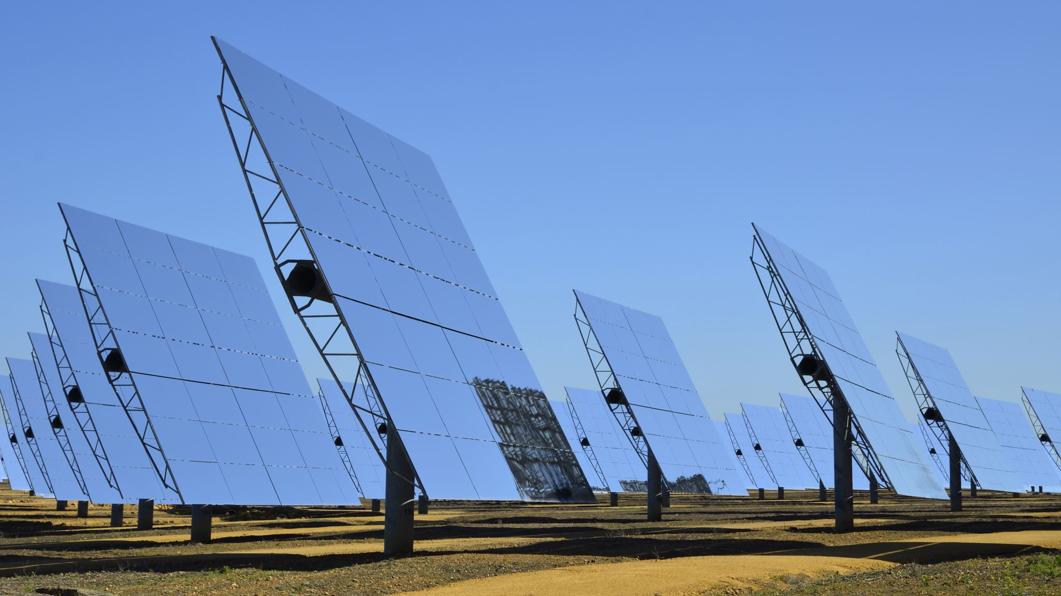
Solar Responders by Nicolas Santillan, Jay Sanders, Alex Wernex, Ryan Hughes

Slide 2
Our Problem
When researching solar panels, we learned that there is no centralized database for first responders and dispatchers to quickly access allowing them to relay information pertaining the specific information to fight fires with solar panels on site.

Slide 3
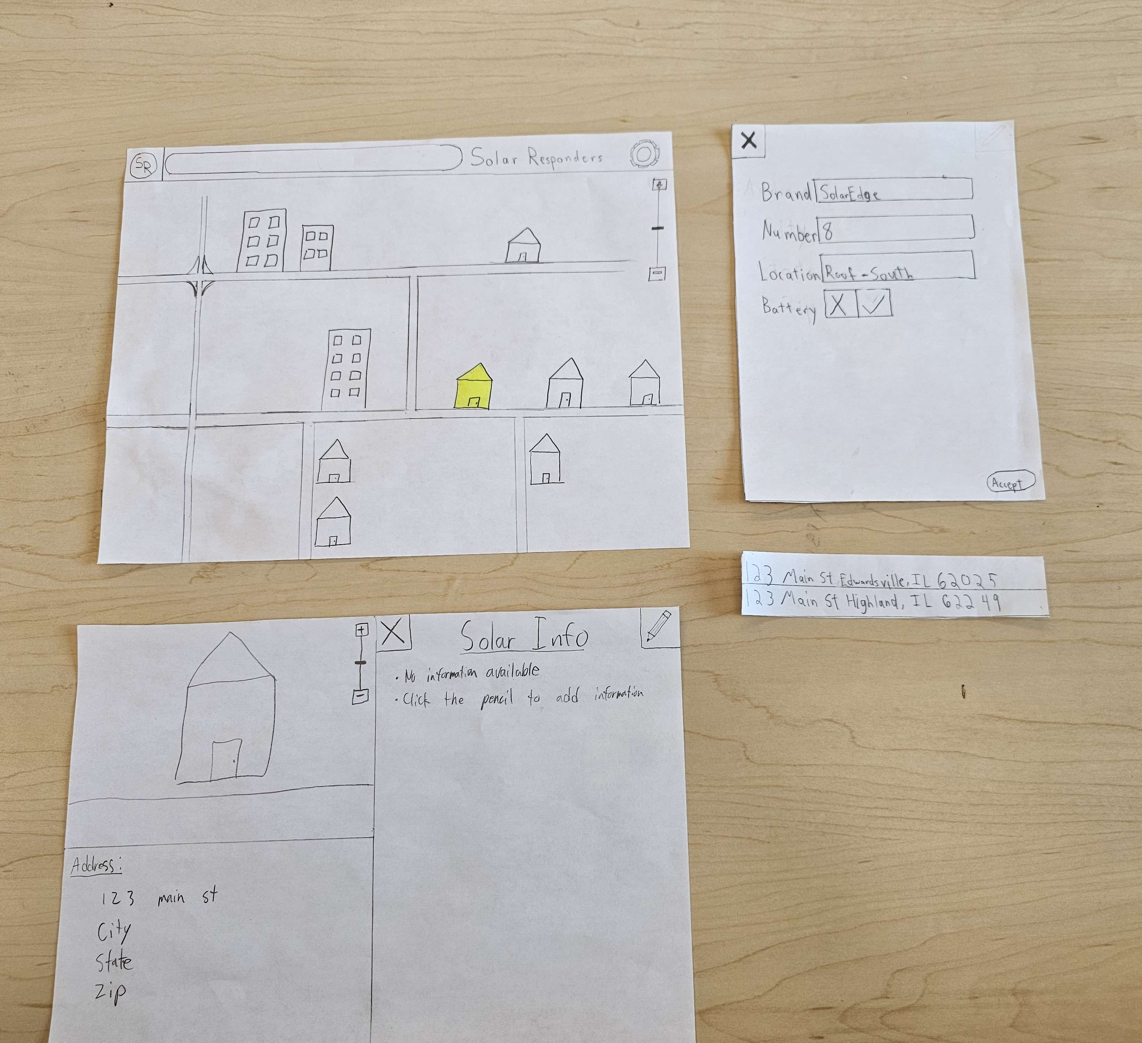
Initial Paper Prototype
Our initial iteration was extremely simplistic with our biggest flaw being a lack of help documentation for users to understand how to navigate the website.
Our two tasks consisted of the user finding the existing information on a house and updating it or a different house.

Slide 4
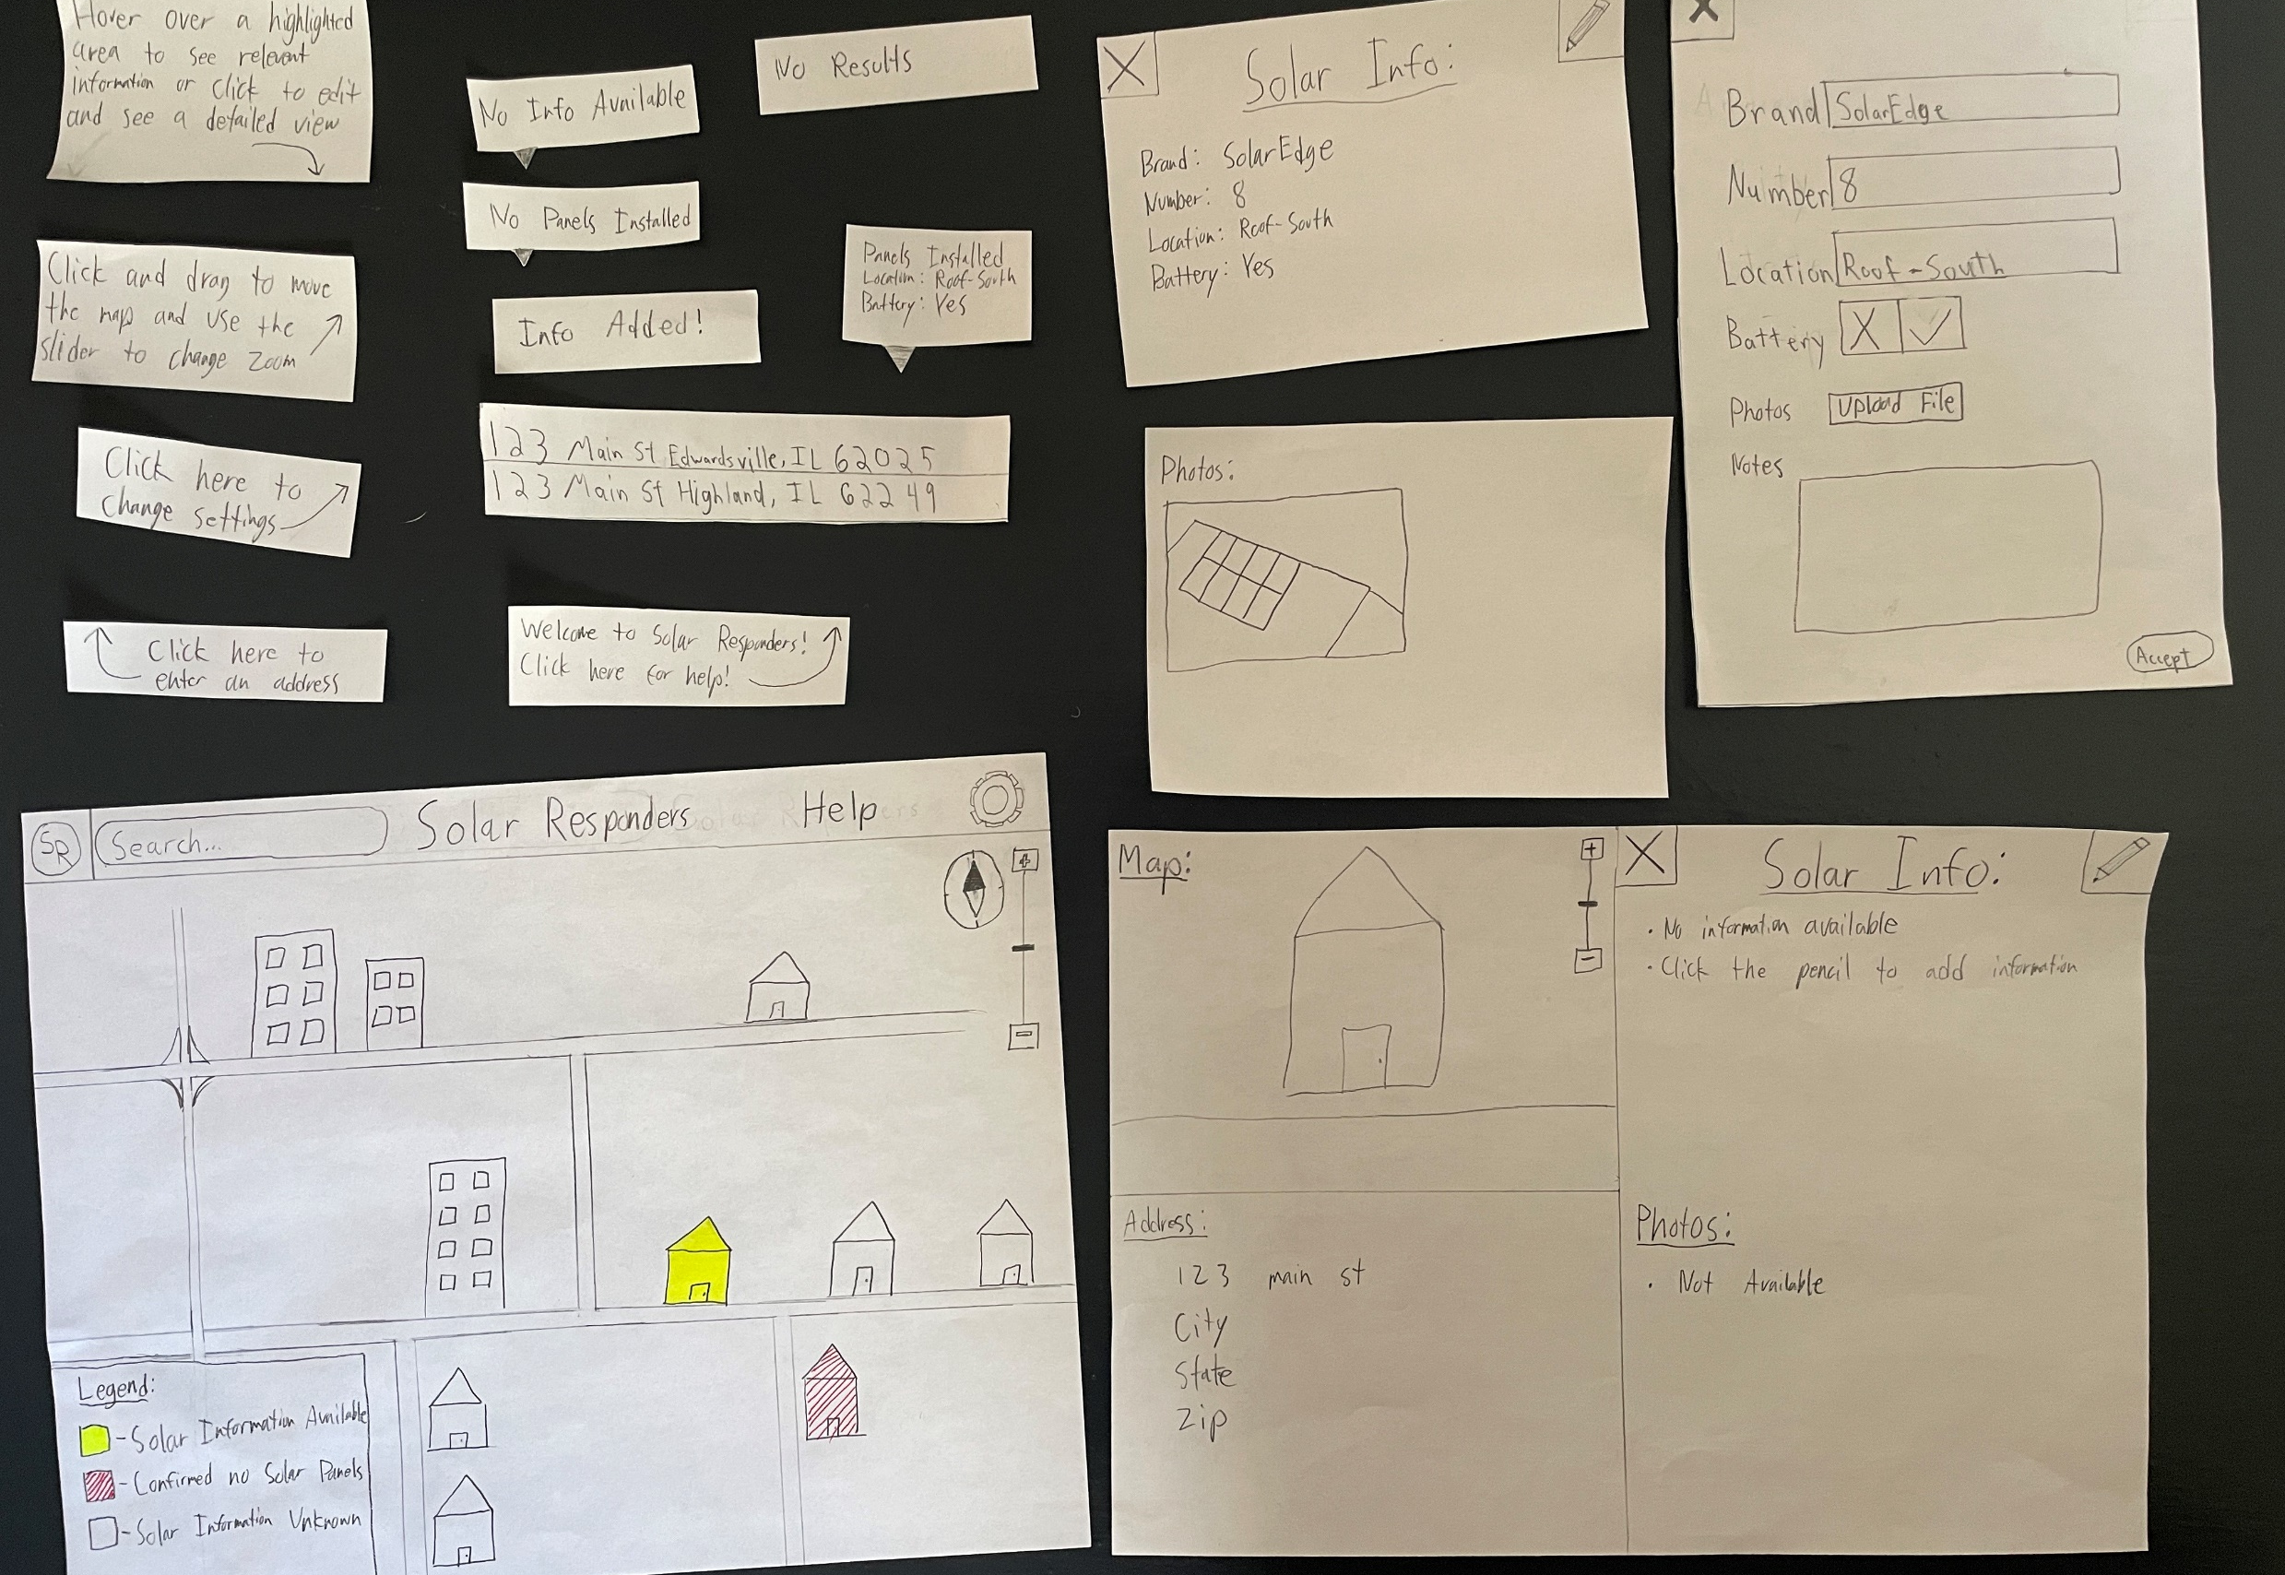
Testing Process and Results
Based on the results we got from our first tests we decided to focus on documentation and user friendliness to make sure anyone can confidently update the database and efficiently access the information no matter their proficiency with a computer.

Slide 5
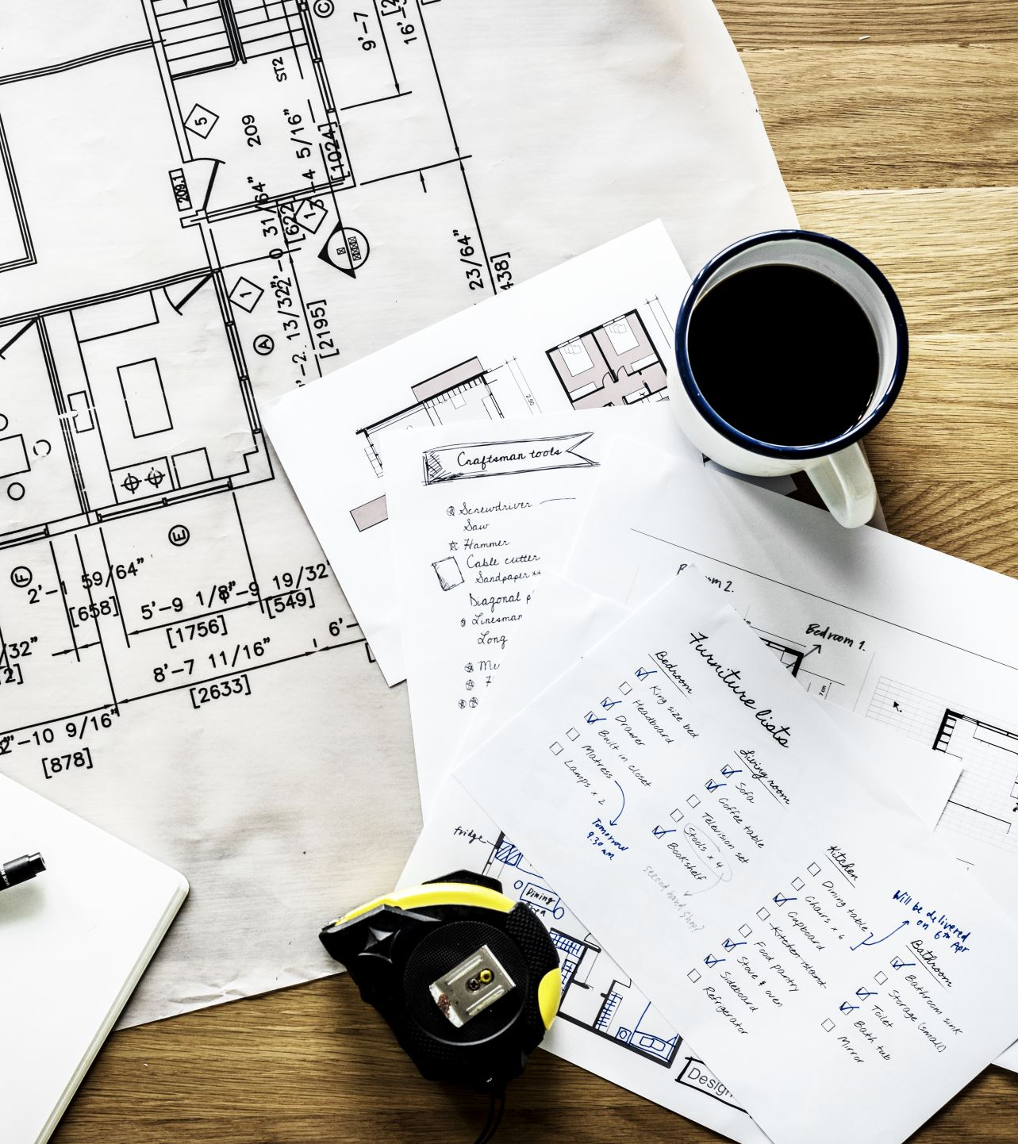
Our Most Critical Changes
Looking back on our initial design compared to the final prototype the most critical changes are the addition of a legend, help menu, and the ability to hover over a house to quickly understand its information.

Slide 6
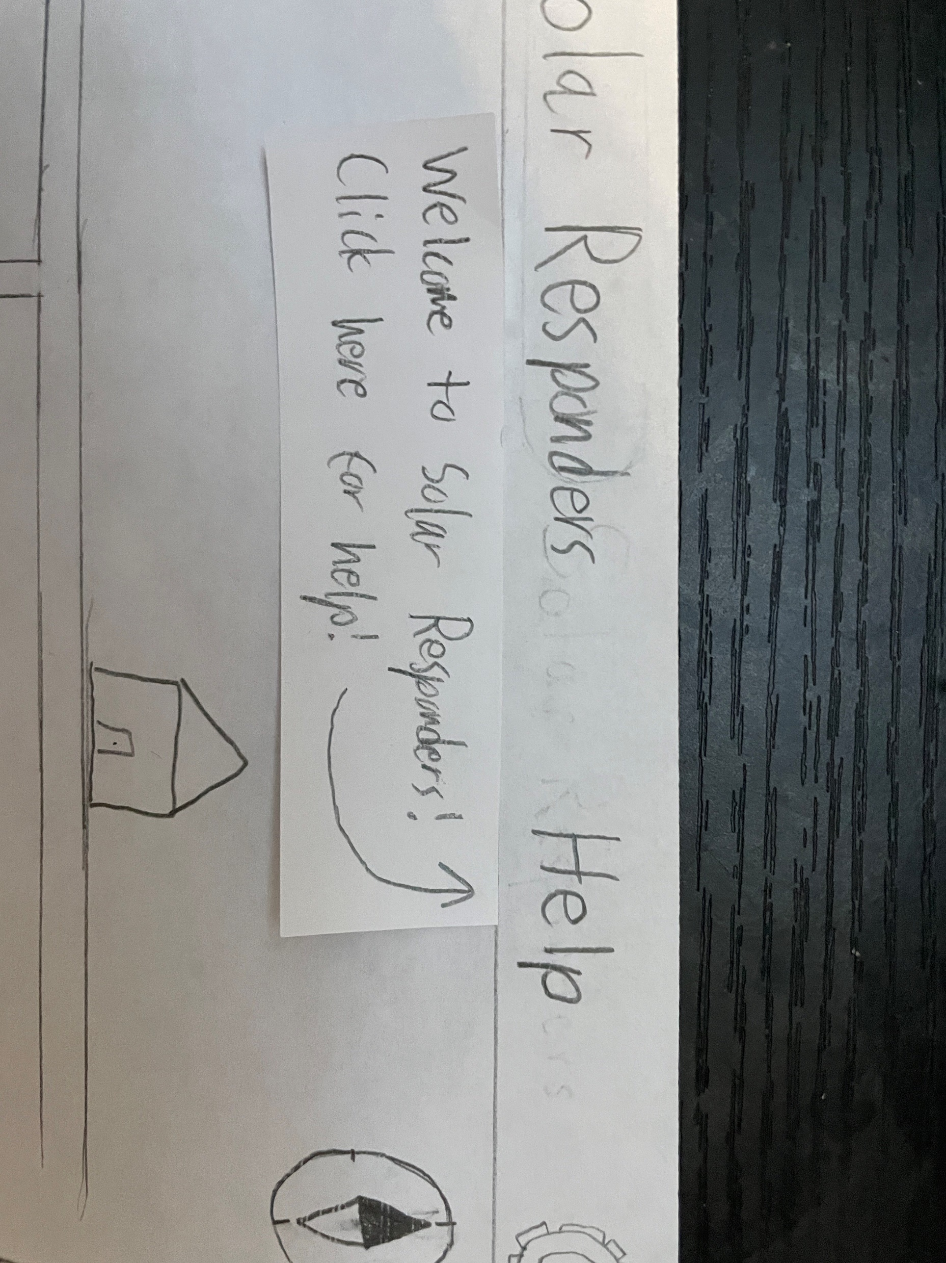
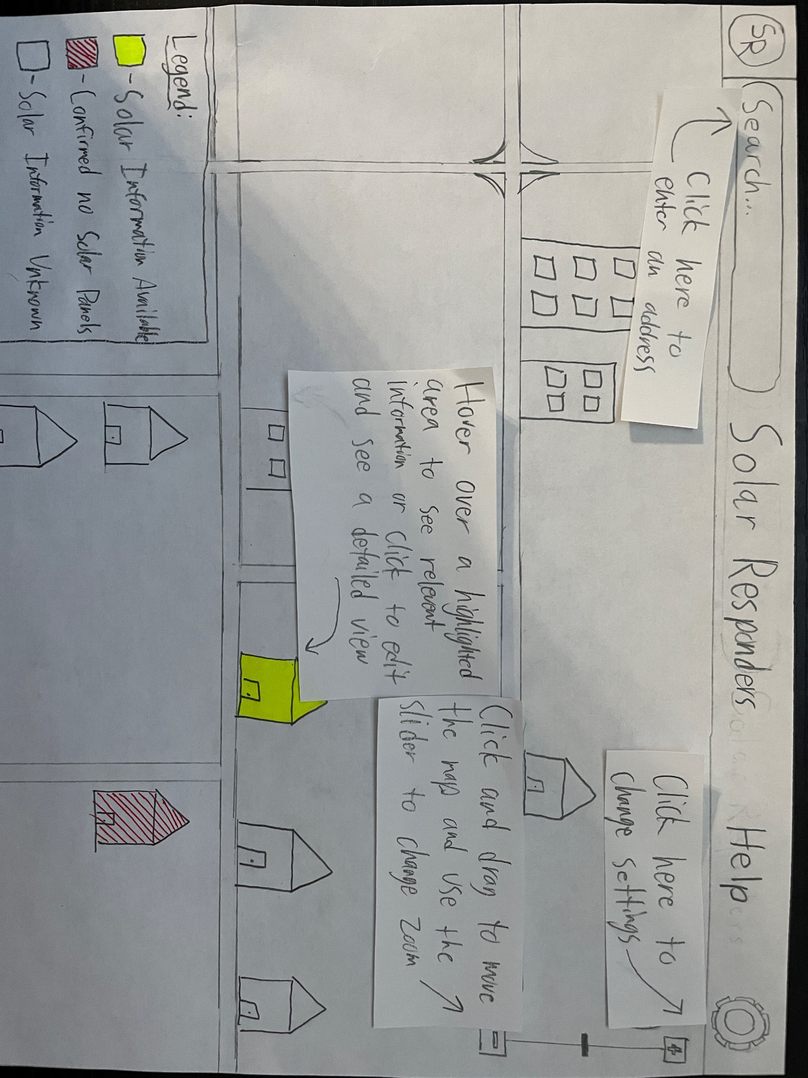
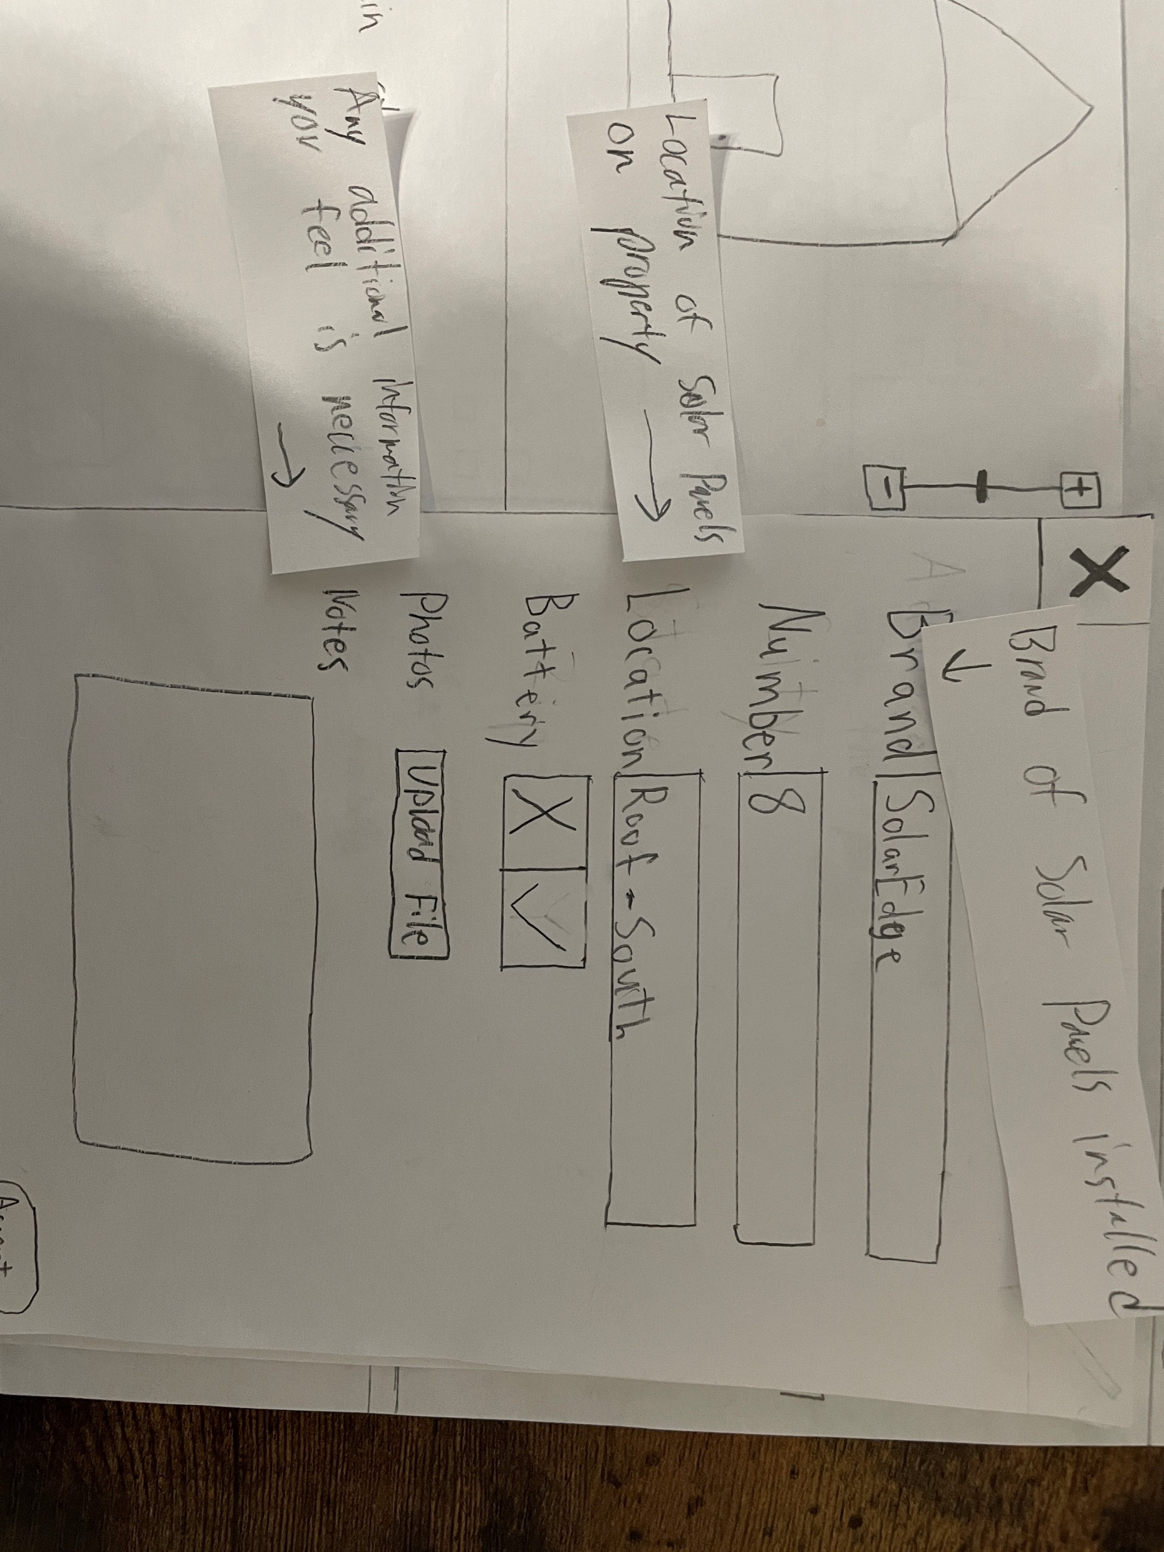
Addition of a Help Menu

Slide 7
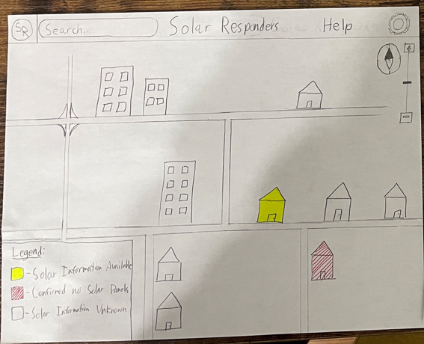
The addition of a Legend

Slide 8
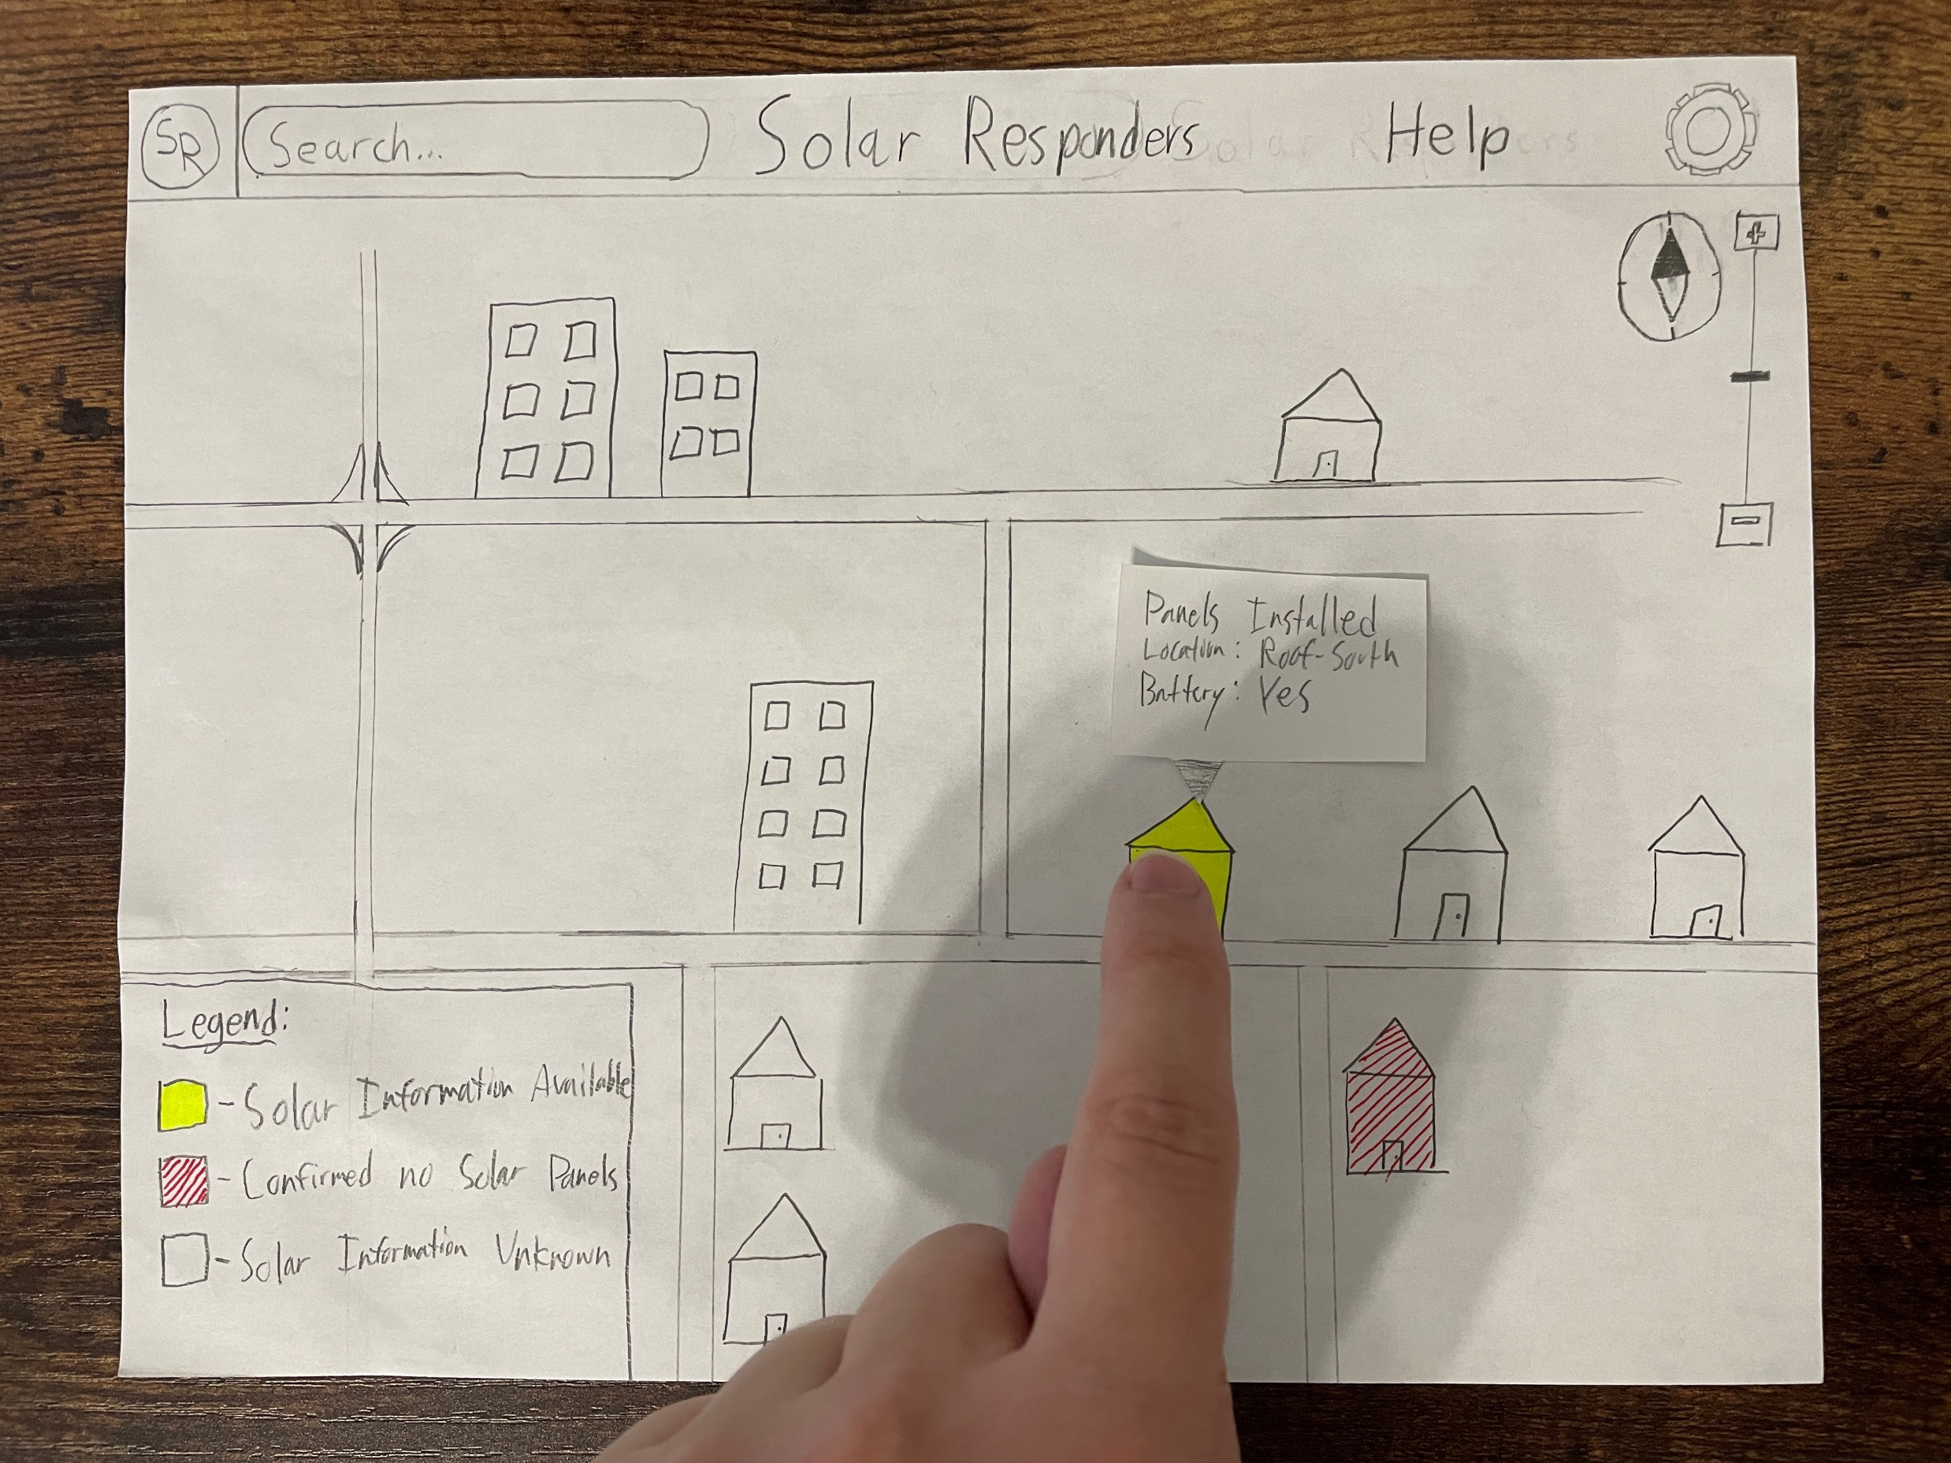
The Addition of Hover for Info

Slide 9
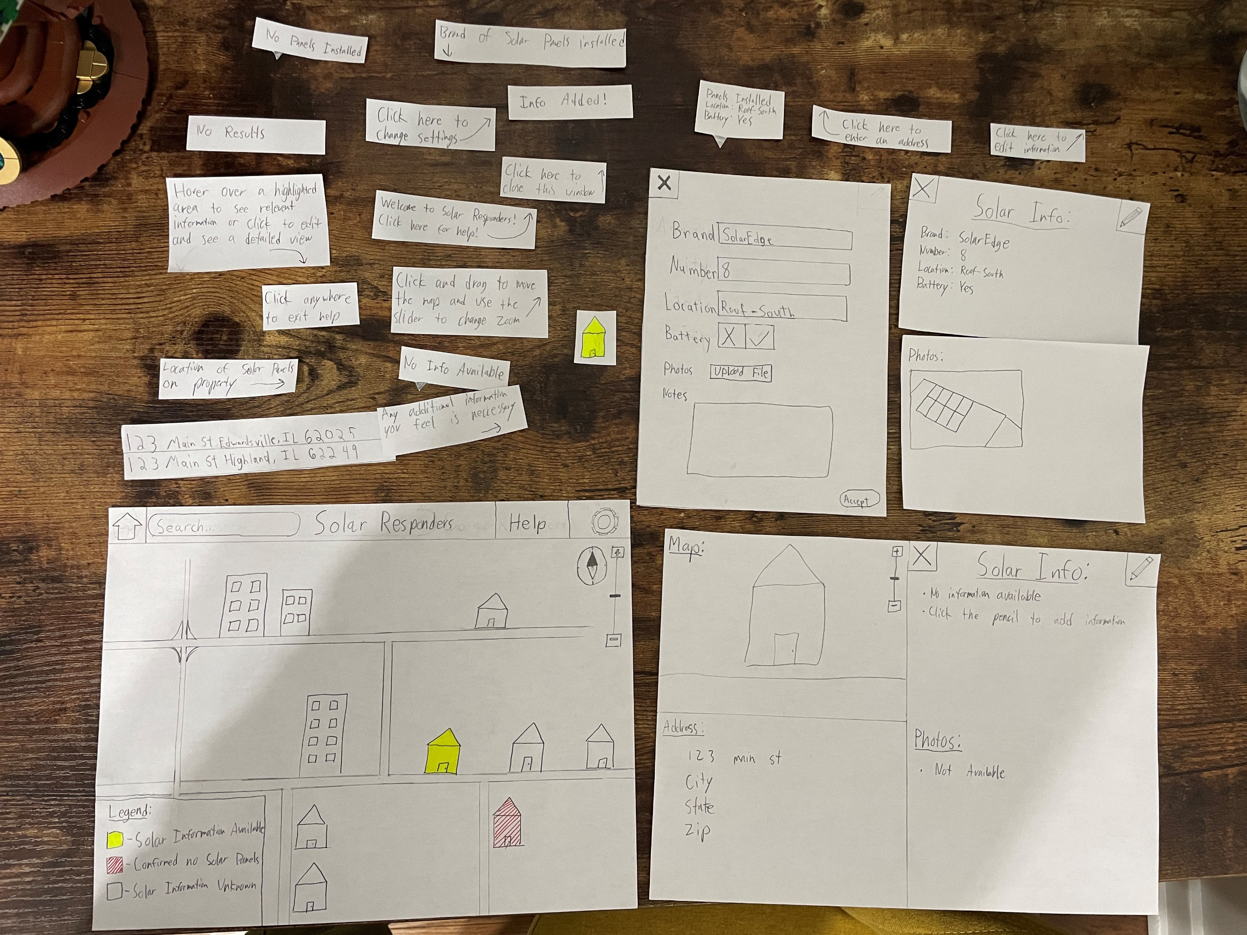
Additional Changes

Slide 10

Final Paper Prototype
Our Critical tasks still consisted of making sure the user could find and edit information on the database with ease.

Slide 11





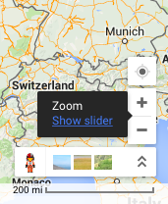
Search…
Solar Responders
Welcome to Solar Responders!
Click here for help
Legend:
Solar info available
Confirmed no solar panels
Solar information unknown

Slide 12
Search…
Solar Responders
Legend:
Solar info available
Confirmed no solar panels
Solar information unknown

Slide 13
Search…
Solar Responders
Click anywhere to exit help
Click here to change settings
Click on the + or – to zoom in or out on the map
Hover over a highlighted area to see relevant information or click to edit and see a detailed view
Legend:
Solar info available
Confirmed no solar panels
Solar information unknown

Slide 14
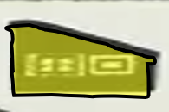



Search…
Solar Responders
Click anywhere to exit help
Map:
Click here to close this window
Solar Info:
Click here to edit information
1 solar panel at this location
Here is the solar panel brand
Brand: SunPower
Here the serial number to the solar panels on site is displayed
Serial Number: mfn59nt5643v
Here is the location the solar panel is facing
Location: Roof-East
This indicates if there are any backup batteries on site
Backup Battery:
Any additional information go here
Notes: Last updated 11/10/2020
Address:
Street Address: 1234 Main St.
City: Edwardsville
Photos:
State: Illinois
Not available
Zip Code: 62025/62026

Slide 15
Search…
Solar Responders
Map:
Solar Info:
1 solar panel at this location
Brand: SunPower
Serial Number: mfn59nt5643v
Location: Roof-East
Backup Battery:
Notes: Last updated 11/10/2020
Address:
Street Address: 1234 Main St.
City: Edwardsville
Photos:
State: Illinois
Not available
Zip Code: 62025/62026

Slide 16
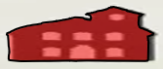
Search…
Solar Responders
Map:
Solar Info:
Confirmed no solar panels at this location
Brand:
Serial Number:
Location:
Backup Battery:
Notes: Last updated 11/10/2020
Address:
Street Address: 1234 Main Ct.
City: Edwardsville
Photos:
State: Illinois
Not available
Zip Code: 62025/62026

Slide 17

Search…
Solar Responders
Map:
Solar Info:
No information currently available
Click the pencil to add information
Address:
Photos:
Street Address: 1234 Main Rd.
Not available
City: Edwardsville
State: Illinois
Zip Code: 62025/62026

Slide 18
Search…
Solar Responders
Map:
Brand:
Imaginary Solar Panels
Serial Number:
4p5v2qkza6ng
Location:
Roof-North
Backup Battery:
Photos:
Upload File
Address:
Street Address: 1234 Main Rd.
Notes:
City: Edwardsville
State: Illinois
Zip Code: 62025/62026
Accept

Slide 19
Search…
Solar Responders
Solar Info:
Brand: SunPower
Serial Number: mfn59nt5643v
Location: Roof-East
Backup Batteries: yes
Legend:
Solar info available
Confirmed no solar panels
Solar information unknown

Slide 20
Search…
Solar Responders
Solar Info:
No information on this house
Legend:
Solar info available
Confirmed no solar panels
Solar information unknown

Slide 21
Search…
Solar Responders
Solar Info:
Confirmed no solar panels on site
Legend:
Solar info available
Confirmed no solar panels
Solar information unknown

Slide 22
Search…
Solar Responders
Legend:
Solar info available
Confirmed no solar panels
Summery
Solar information unknown

Slide 23
Search…
Solar Responders
Map:
Solar Info:
1 solar panel at this location
Brand: SunPower
Serial Number: mfn59nt5643v
Location: Roof-East
Backup Battery:
Notes: Last updated 11/10/2020
Address:
Street Address: 1234 Main St.
City: Edwardsville
Photos:
State: Illinois
Not available
Zip Code: 62025/62026

Slide 24
Search…
Solar Responders
Map:
Solar Info:
Confirmed no solar panels at this location
Brand:
Serial Number:
Location:
Backup Battery:
Notes: Last updated 11/10/2020
Address:
Street Address: 1234 Main Ct.
City: Edwardsville
Photos:
State: Illinois
Not available
Zip Code: 62025/62026

Slide 25

Search…
Solar Responders
Map:
Solar Info:
1 solar panel at this location
Brand: Imaginary Solar Panels
Serial Number: 4p5v2qkza6ng
Location: Roof-North
Backup Battery:
Notes: Last updated 11/13/2023
Address:
Street Address: 1234 Main Rd.
City: Edwardsville
Photos:
State: Illinois
Not available
Zip Code: 62025/62026

Slide 26
Search…
Solar Responders
Map:
Solar Info:
1 solar panel at this location
Brand: Imaginary Solar Panels
Serial Number: 4p5v2qkza6ng
Location: Roof-North
Info Added!
Backup Battery:
Notes: Last updated 11/13/2023
Address:
Street Address: 1234 Main Rd.
City: Edwardsville
Photos:
State: Illinois
Not available
Zip Code: 62025/62026

Slide 27
Search…
Solar Responders
Solar Info:
Brand: SunPower
Serial Number: mfn59nt5643v
Location: Roof-East
Backup Batteries: yes
Legend:
Solar info available
Confirmed no solar panels
Solar information unknown

Slide 28
Search…
Solar Responders
Solar Info:
Brand: Imaginary Solar Panels
Serial Number: 4p5v2qkza6ng
Location: Roof-North
Backup Batteries: no
Legend:
Solar info available
Confirmed no solar panels
Solar information unknown

Slide 29
Search…
Solar Responders
Solar Info:
Confirmed no solar panels on site
Legend:
Solar info available
Confirmed no solar panels
Solar information unknown

Slide 30

Lessons Learned in Design Process
We learned that even if we thought our database was simple user friendliness can always be improved.
We also learned at first that quantity over quality can work since you can build off the many different iterations of a prototype.

